Slide 1
Quantum Security for
the Fiat-Shamir Transform
Based on
J. Don, S. Fehr, C. Majenz, C. Schaffner, ”Security of the Fiat-Shamir
Transformation in the Quantum Random Oracle Model.” CRYPTO 2019, pp 356-383,
and the “Picnic” submission.
February 11, 2020, NIST Postquantum Crypto Seminar
Carl A. Miller
(Not for public distribution.)

Slide 2
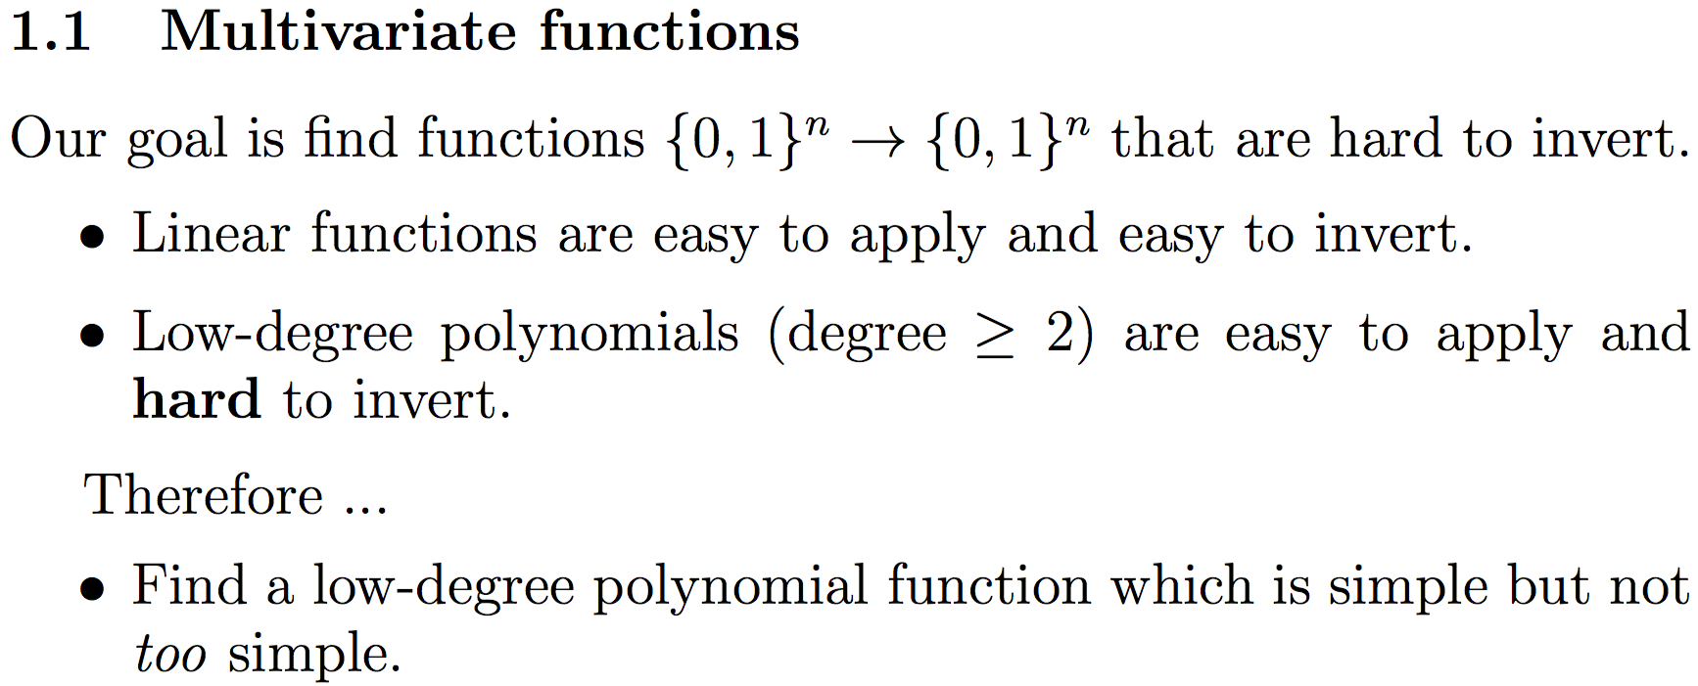
The Basics
The Fiat-Shamir transform can be used to turn interactive proofs-of-knowledge into digital signature schemes.
This paper shows that Fiat-Shamir is secure in the quantum random oracle model (QROM).
They offer some tentative applications to NIST PQC candidates.

Slide 3
Fiat-Shamir in the Classical Context

Slide 4

The Random Oracle Model
A hash function is an (efficiently computable) function
$$h:{\left\{0,1\right\}}^{n}→{\left\{0,1\right\}}^{m}$$
which behaves a lot like a random function.
In a security proof “in the random oracle model,” each use of the hash function is replaced by a black box,
$a b$
which chooses a random output for each new input.

Slide 5

Σ-Protocols
Three rounds:
Commit.
Challenge.
Verify.
Bob then checks that a predicate P (x, e, w) holds.
x
e (uniformly random)
w
P (x, e, w)

Slide 6
Σ-Protocols
These are useful when there is a bit string s such that:
- Alice can efficiently satisfy P if she knows s;
- With no information, Alice can’t efficiently satisfy P.
(Proof of knowledge.)
x
e (uniformly random)
w
s
P (x, e, w)

Slide 7
Fiat-Shamir Transform
Alice uses a hash function H to compute e.
x
e
w
s

Slide 8
Fiat-Shamir Transform
Alice uses a hash function H to compute e.
Bob simply checks P on the hash.
(To make this a signature scheme, hash the message m as well.)
x
H(x)
w
s
P (x, H (x), w)

Slide 9
Fiat-Shamir Transform
Alice uses a hash function H to compute e.
Bob simply checks P on the hash.
(To make this a signature scheme, hash the message m as well.)
x
H(x, m)
w
s
P (x, H (x, m), w)

Slide 10



Fiat-Shamir is Secure in the ROM
Suppose that Z is a Σ-protocol, and Alice has an algorithm that works for Fiat (Z ) with non-negligible prob.
She wants an algorithm that works for Z.
x
H(x)
$$A_{0}$$
$$A_{1}$$
…
$$A_{r}$$
w

Slide 11
Fiat-Shamir is Secure in the ROM
For i = 1, …, r, let p_i be the probability that the protocol succeeds and that the final pair (x, H( x)) was generated on the ith query.
Let p = overall probability of success.
x
H(x)
$$A_{0}$$
$$A_{1}$$
…
$$A_{r}$$
w
2nd query

Slide 12
Fiat-Shamir is Secure in the ROM
Alice chooses a random round i. On the ith round (only) she uses Bob in place of the random oracle.
She then finishes as usual.
x
x’
e’
$$A_{0}$$
$$A_{1}$$
…
$$A_{r}$$
x
e
w’
e (uniformly random)

Slide 13

Fiat-Shamir is Secure in the ROM
W/ prob. $p_{i}$, the output will include x and e as desired.
x
x’
e’
$$A_{0}$$
$$A_{1}$$
…
$$A_{r}$$
x
e
w’
e (uniformly random)

Slide 14
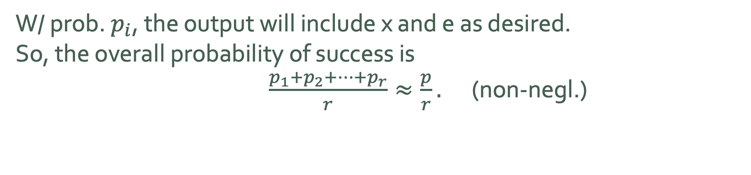
Fiat-Shamir is Secure in the ROM
W/ prob. $p_{i}$, the output will include x and e as desired.
So, the overall probability of success is
$\frac{p_{1}+p_{2}+…+p_{r}}{r}≈\frac{p}{r}.$ (non-negl.)
x
x
e
$$A_{0}$$
$$A_{1}$$
…
$$A_{r}$$
x
e
w’
e (uniformly random)

Slide 15
The Quantum Random Oracle Model

Slide 16

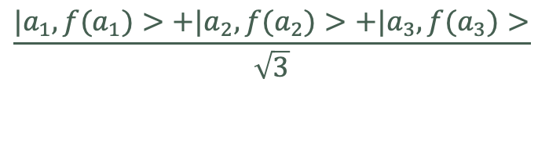

The QROM
A quantum random oracle is initiated by choosing a random function
$$f:{\left\{0,1\right\}}^{n}→{\left\{0,1\right\}}^{m}$$
The oracle accepts bit strings in superposition and returns outputs in superposition.
$$\frac{{|a}_{1}>+|a_{2}>+|a_{3}>}{\sqrt{3}}$$
$$\frac{{|a_{1},f(a}_{1})>+|a_{2}, f(a_{2})>+|{a_{3},f(a}_{3})>}{\sqrt{3}}$$

Slide 17
The QROM
Trying to adapt the previous Fiat-Shamir argument here raises multiple issues. (One is that measuring the input to a QROM disturbs it.)
We could use the Unruh transform.
That’s known to work, although it’s more complicated.

Slide 18


Fiat-Shamir is Secure in the QROM
Suppose that Z is a Σ-protocol, and Alice has a quantum algorithm that works for Fiat (Z ) with non-negligible prob.
She wants an algorithm that works for Z.
State preparation
Unitary
Unitary
φ
$$U_{1}$$
…
$$U_{i}$$
…

Slide 19

Fiat-Shamir is Secure in the QROM
Alice runs the protocol until a randomly chosen round $i.$
She measures x, sends it to Bob, receives e.
State preparation
Unitary
Unitary
φ
$$U_{1}$$
…
$$U_{i}$$
x

Slide 20
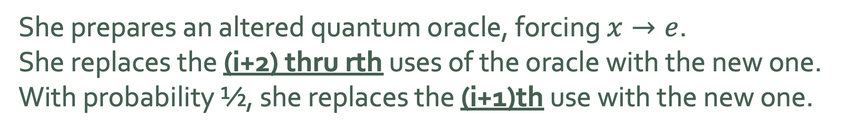
Fiat-Shamir is Secure in the QROM
She prepares an altered quantum oracle, forcing $x→e$.
She replaces the (i+2) thru rth uses of the oracle with the new one.
With probability ½, she replaces the (i+1)th use with the new one.
State preparation
Unitary
Unitary
φ
$$U_{1}$$
…
$$U_{i}$$
…
x

Slide 21
Fiat-Shamir is Secure in the QROM
She prepares an altered quantum oracle, forcing $x→e$.
She replaces the (i+2) thru rth uses of the oracle with the new one.
With probability ½, she replaces the (i+1)th use with the new one.
State preparation
Unitary
Unitary
φ
$$U_{1}$$
…
$$U_{i}$$
…
x

Slide 22

Fiat-Shamir is Secure in the QROM
She prepares an altered quantum oracle, forcing $x→e$.
She replaces the (i+2) thru rth uses of the oracle with the new one.
With probability ½, she replaces the (i+1)th use with the new one.
State preparation
Unitary
Unitary
φ
$$U_{1}$$
…
$$U_{i}$$
…
x

Slide 23
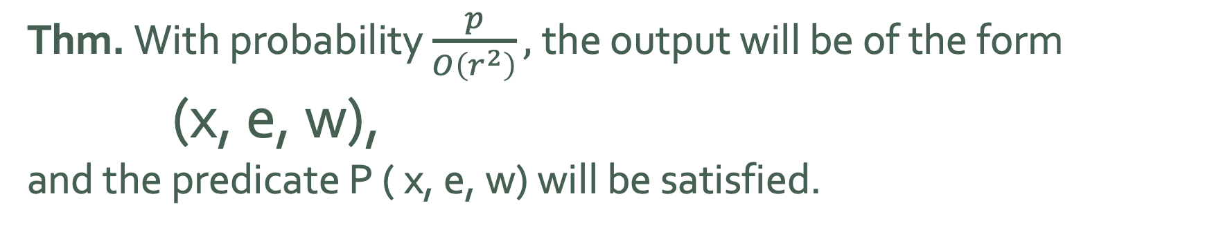
Fiat-Shamir is Secure in the QROM
Thm. With probability $\frac{p}{O\left(r^{2}\right)},$the output will be of the form
(x, e, w),
and the predicate P ( x, e, w) will be satisfied.
State preparation
Unitary
Unitary
φ
$$U_{1}$$
…
$$U_{i}$$
…
x

Slide 24
Fiat-Shamir is Secure in the QROM
Conclusion: If Alice can win Fiat (Z ) with non-negligible probability, then she can win Z with non-negligible probability.
State preparation
Unitary
Unitary
φ
$$U_{1}$$
…
$$U_{i}$$
…
x

Slide 25
Applications to PQC Candidates?

Slide 26
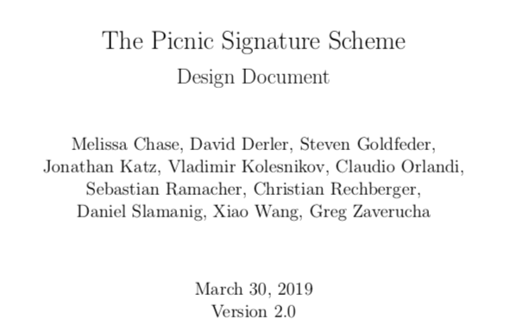
Picnic
In Picnic, the designers take two Σ-protocols (ZKB++ and KKW) and apply Fiat-Shamir and Unruh transforms to construct signatures schemes.
J. Don et al. explain a proof, via their main result, of a scheme similar to Picnic.
They also briefly address lattice-based schemes.

